Slide 1
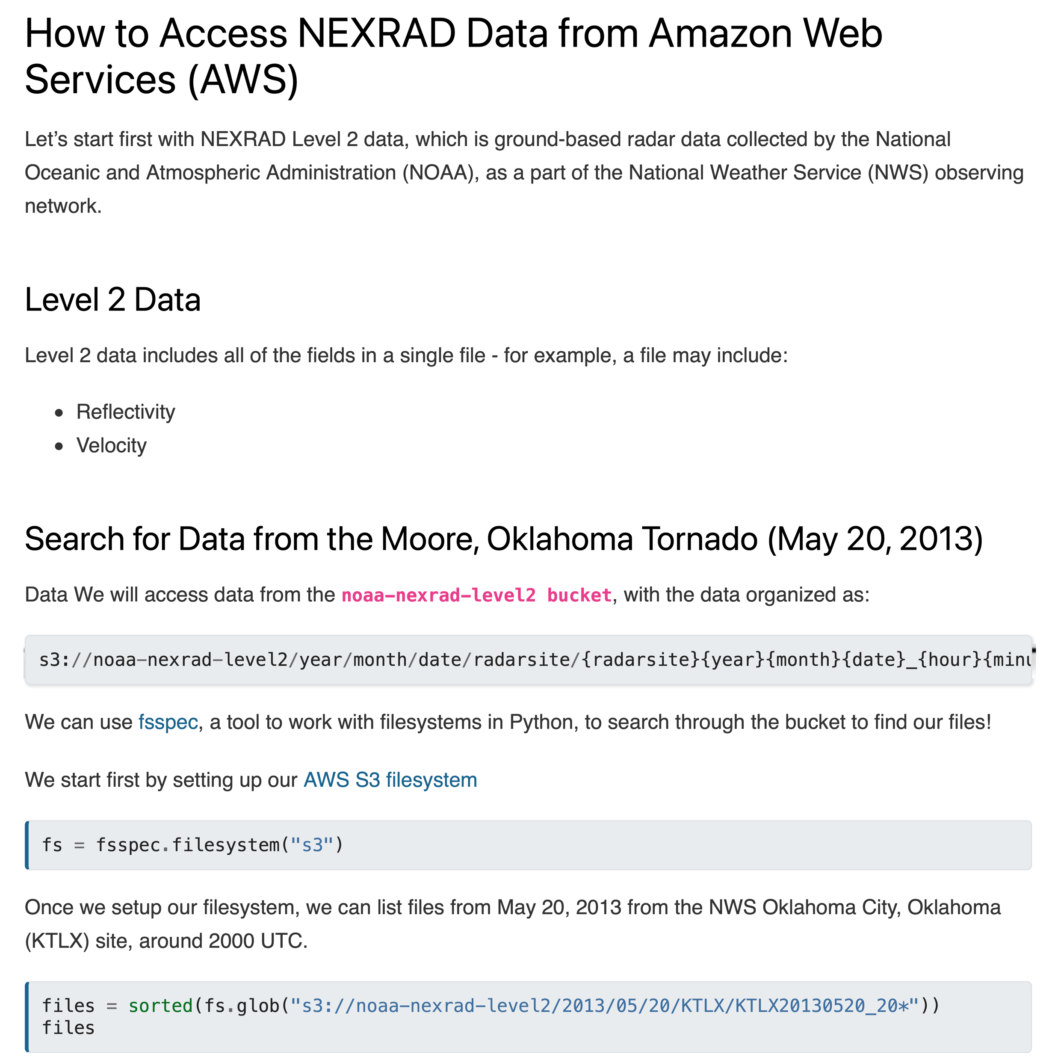

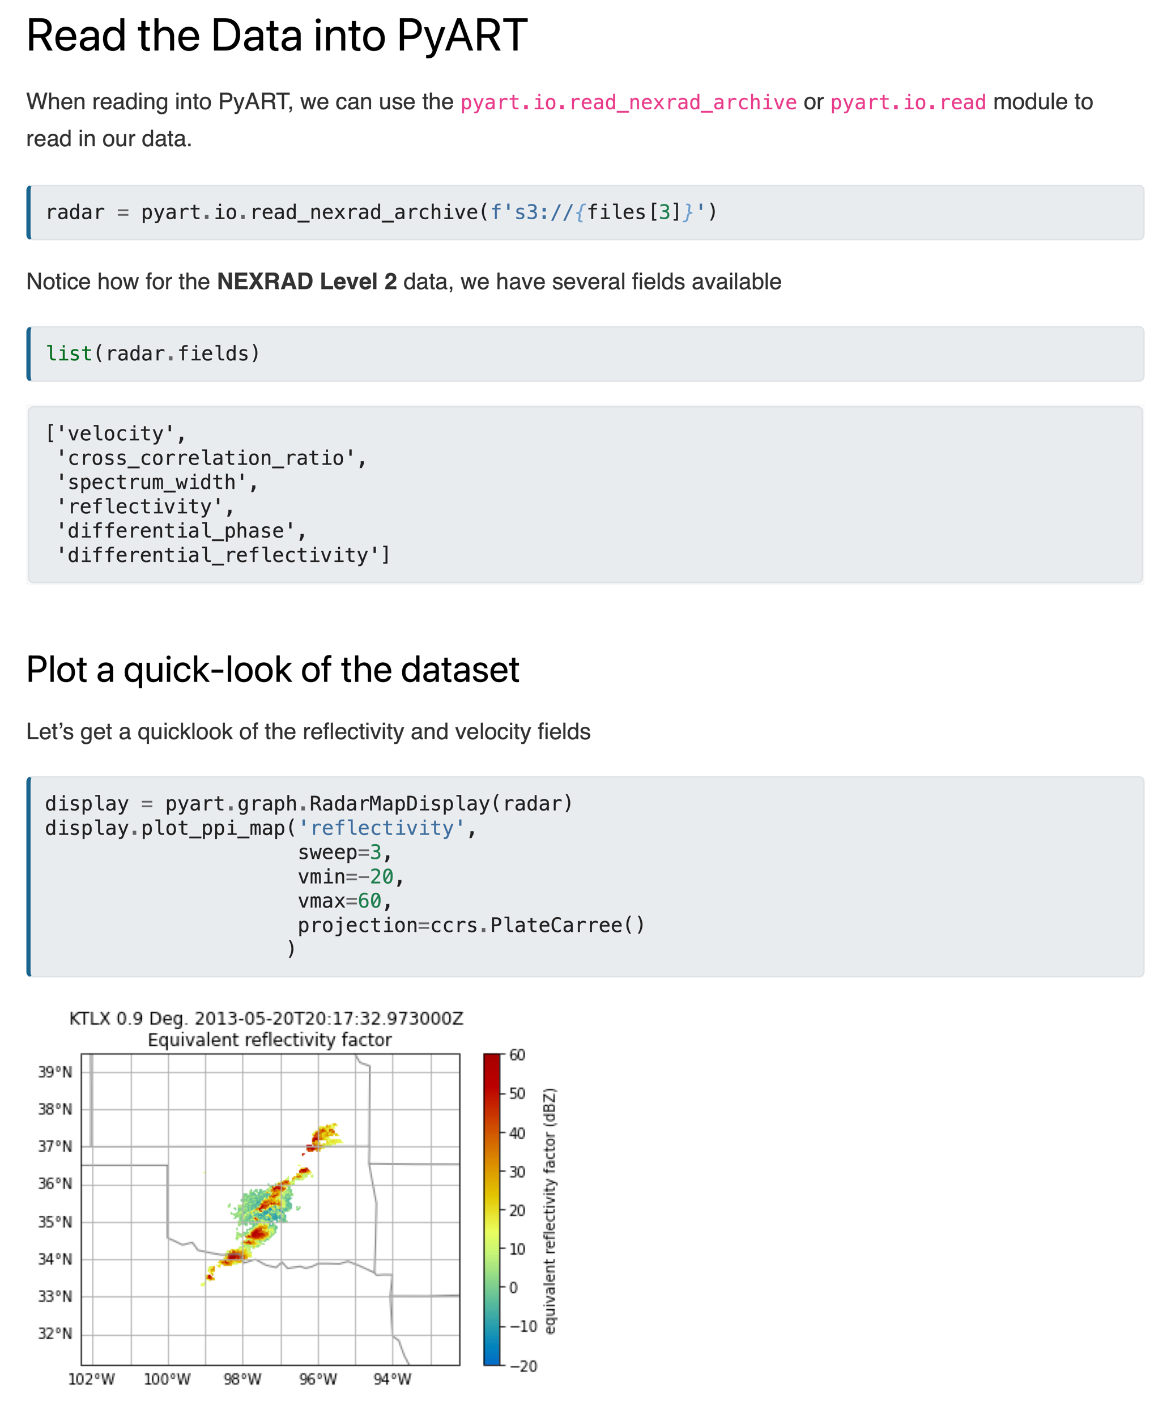
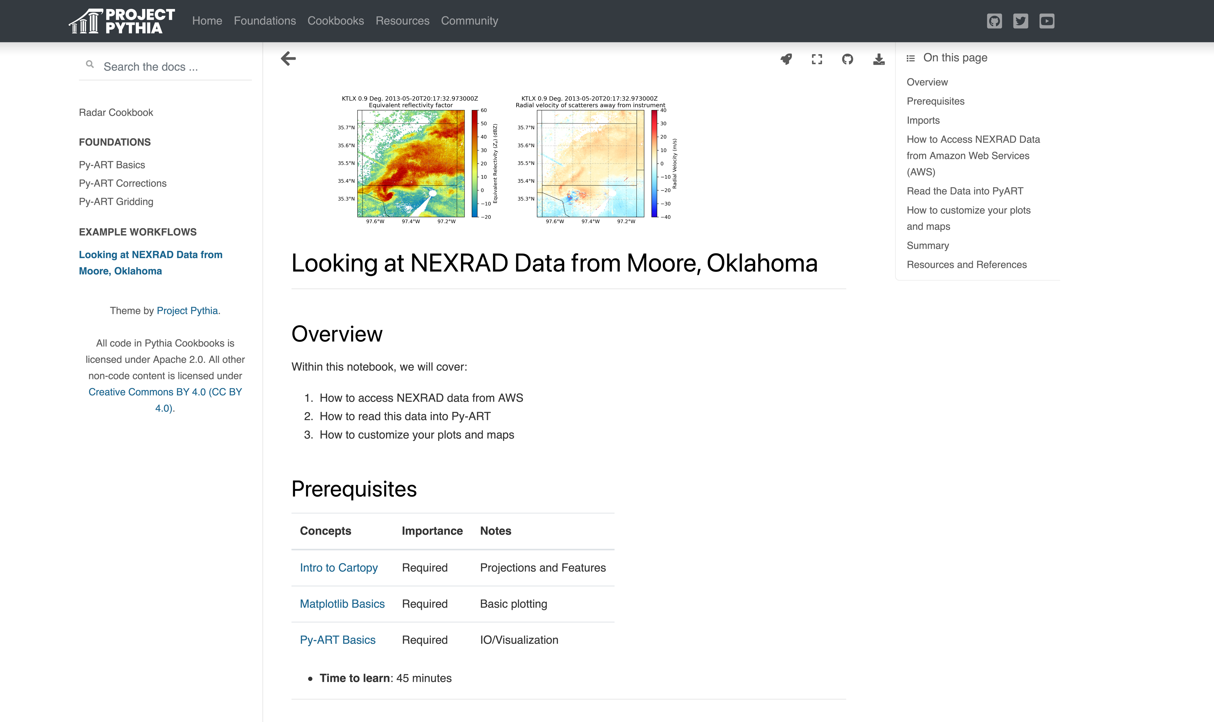
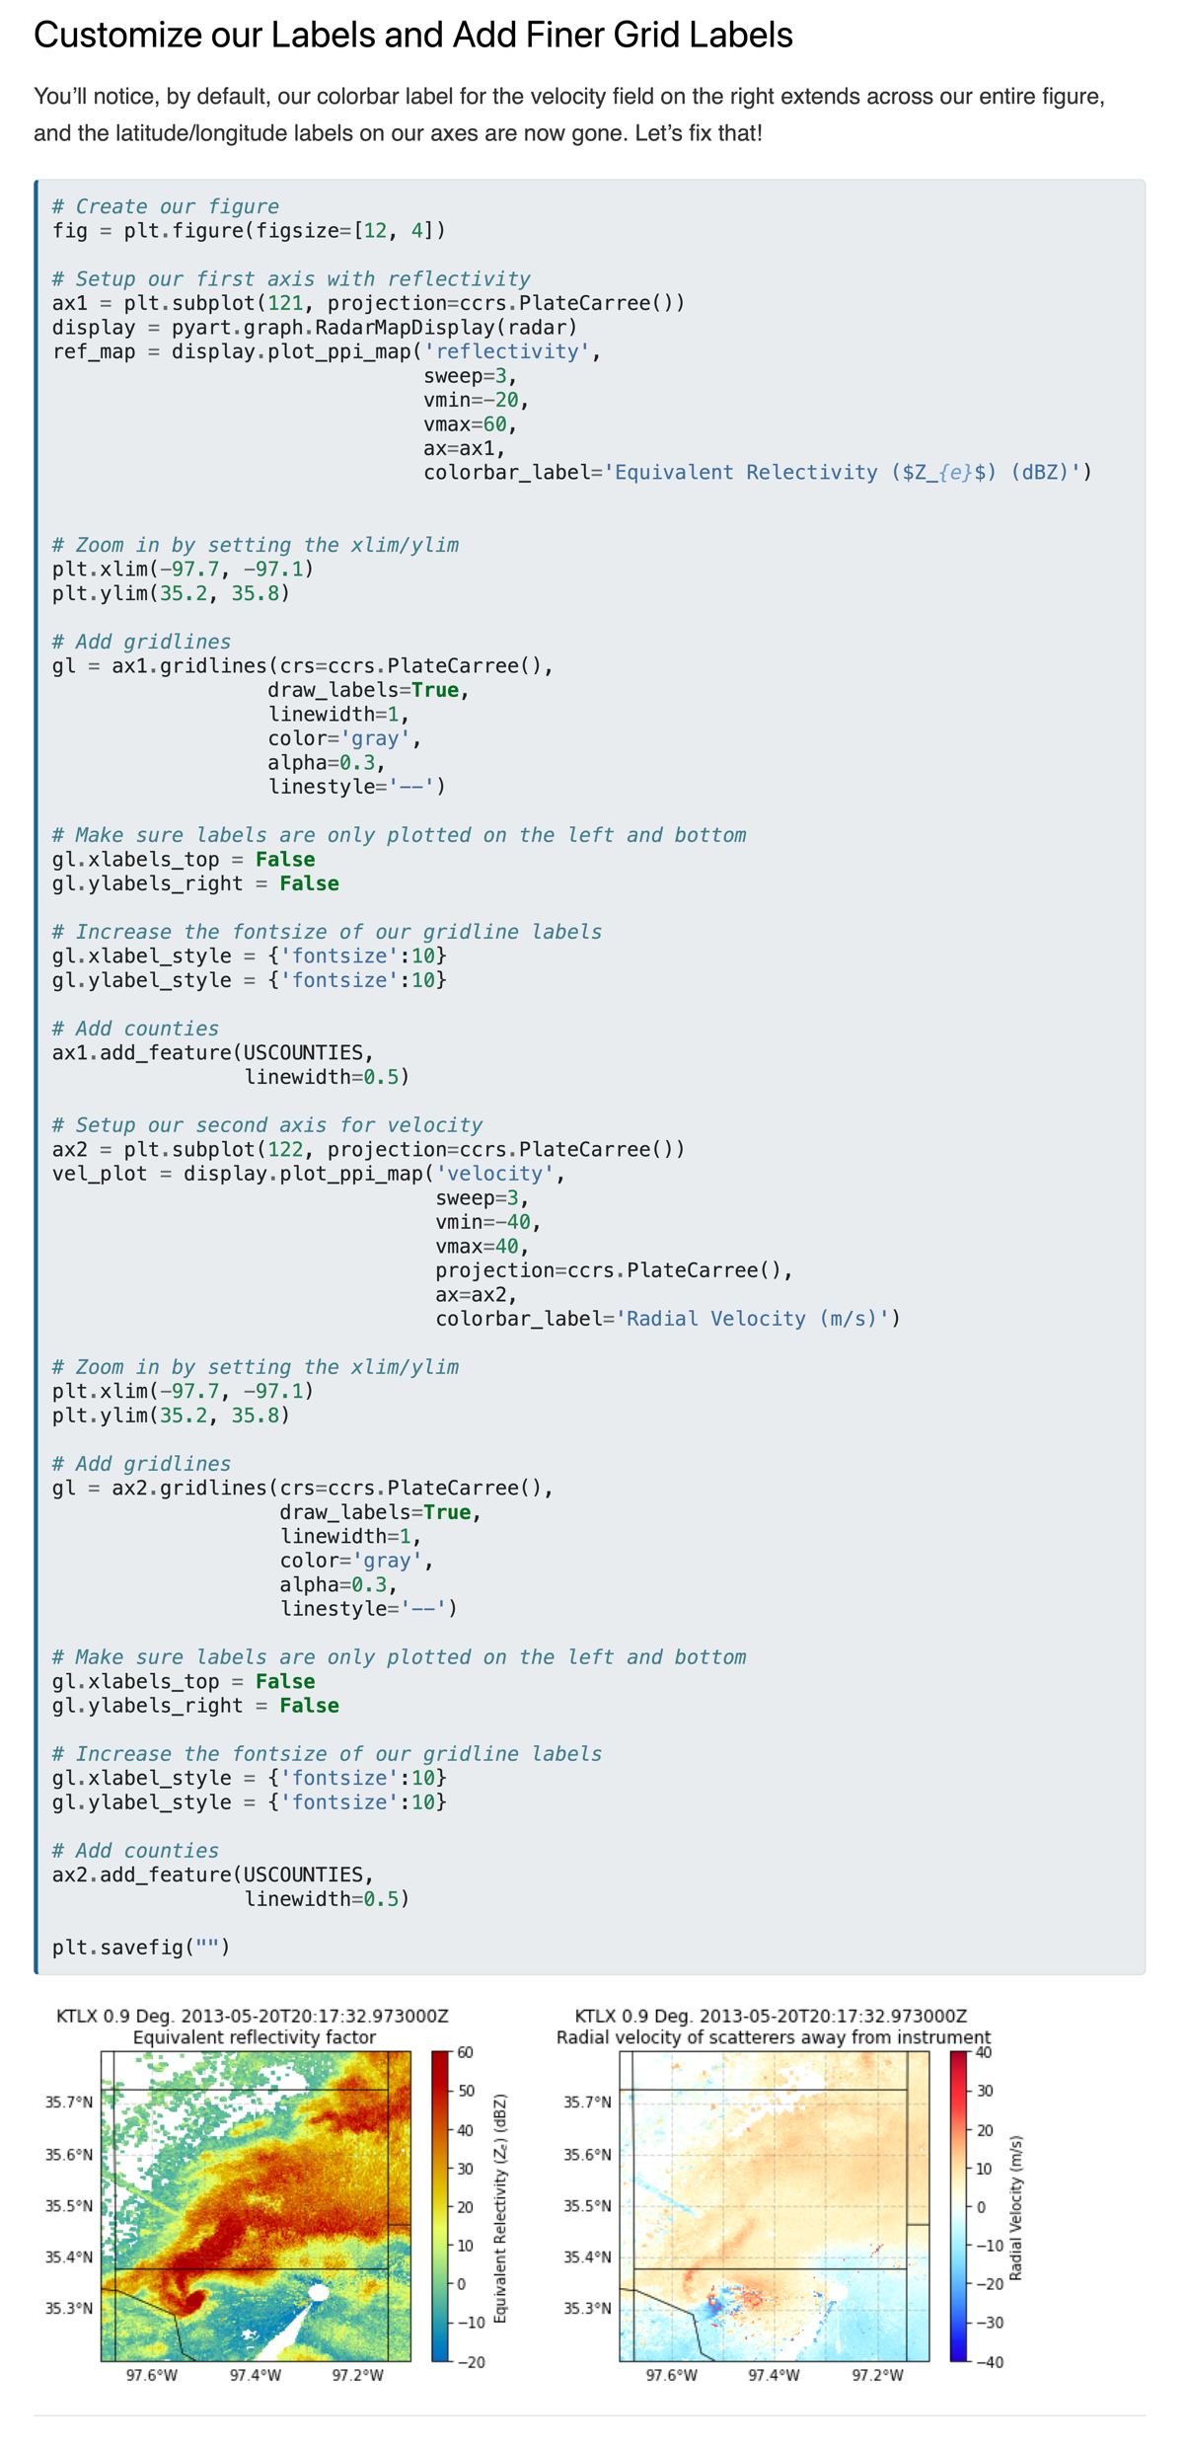
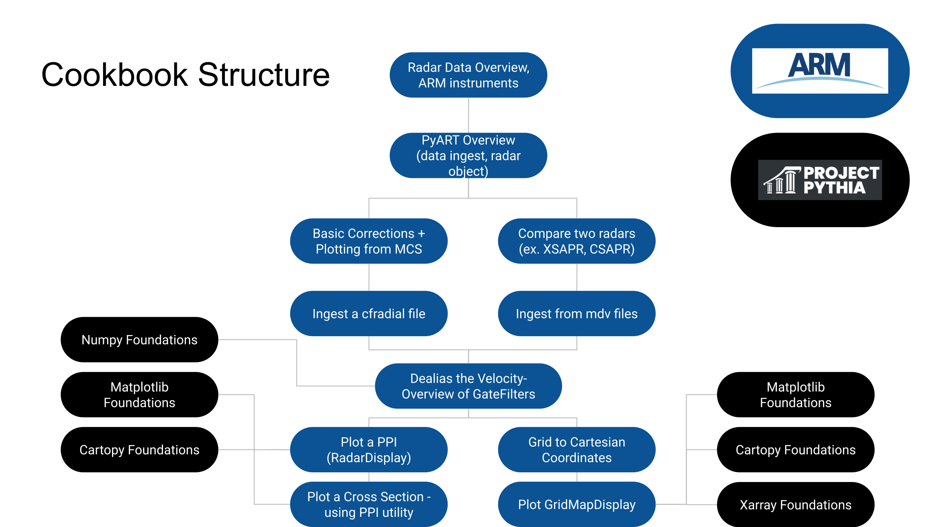
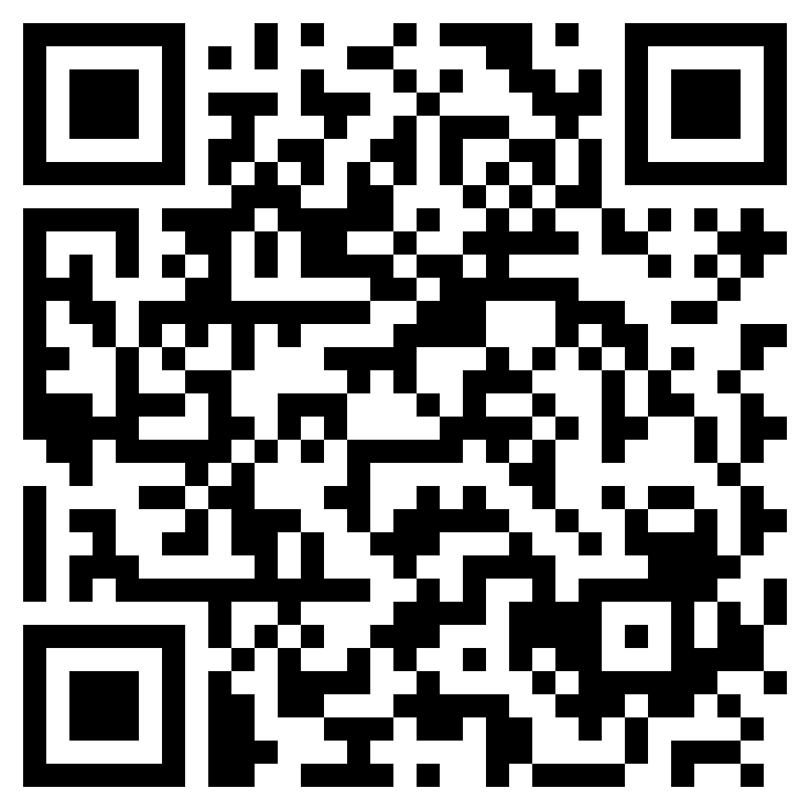


Open Science analysis cookbooks were developed, focusing on analyzing weather radar data.
Opening ARM: Developing Open-Science Cookbooks Leveraging Users, Data, and Infrastructure
Sherman¹
PRESENTER:
Maxwell Grover¹
Zachary Sherman¹, Scott Collis¹, Jitendra Kumar², Adam Thiesen¹, Bobby Jackson¹, Kevin Tyle³, Julia Kent⁴, Drew Camron⁵
¹Argonne National Laboratory
²Oak Ridge National Laboratory
³University at Albany
⁴National Center for Atmospheric Research
⁵Unidata Program Office
BACKGROUND: We developed scientific analysis cookbooks, extending upon foundational Python material from Project Pythia, focused around working with radar weather data.
Py-ART is an open-source Python package focused on reading, cleaning, and plotting weather radar data, funded by the Atmospheric Radiation Measurement (ARM) User Facility
METHODS
Collected previous Py-ART tutorial materials
Defined foundational Py-ART material
Determined which Project Pythia foundational material we could link to
Here is an example flowchart showing this process
Take a picture to checkout the cookbook
Notes:
Notes:
In Powerpoint, click View > Guides
Keep text within gutter guides.
Author list: Don’t split names onto two lines (e.g., “Jimmy [break] Smith”). If that happens, use a new line, unless you need the space. Bold the first names of anybody who’s presenting in person.
Intro/methods/result: Do not drop below font size 28, but if you have extra space, jack up the font size until the space is full.
Do not use color in the sidebars except in graphs/figures. It’ll pull attention from the center and slow interpretation for passersby.

